Slide 1
Modeling Memory: Exploring the Relationship Between Word Overlap and Single Word Norms When Predicting Judgments and Recall
Nicholas P. Maxwell
Notes:
Today I will be briefly sharing a research project that I have been conducting on the effects of word pair relationships and judgements of these relationships on recall task performance.

Slide 2
Introduction
Different ways to judge item relatedness:
How often are two words used together? (associative)
Measured with Forward Strength
How similar in meaning are two words? (semantic)
Measured with Cosine
How closely are two words connected by an overall theme? (thematic)
Measured with Latent Semantic Analysis
Notes:
The present study has participants making judgements of how related pairs of words are based on the following three measures of relatedness:
Associative
Semantic
Thematic

Slide 3
Judgments of Associative Memory (JAM)
Manipulated JOL task that investigates perception of word associations
Maki (2007a, 2007b)
Participants are asked to estimate the number of people out of 100 who would respond to the cue with the given target
These ratings mimic the free association process used to create word association norms

Slide 4
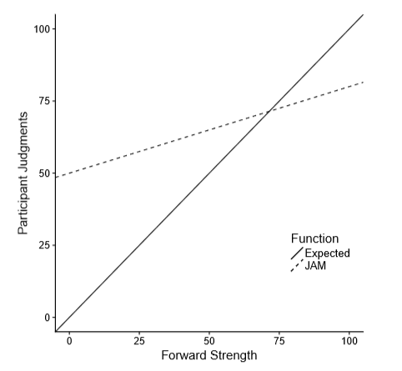
JAM Function
The JAM Function
Characterized by a high intercept and shallow slope
One goal of present study was to replicate this function for associative judgments and then extend it to include semantic and thematic judgments.

Slide 5
Goals
Replicate interaction findings from Experiment One with a new stimuli set
Expand upon these findings by including single word norms in the analysis

Slide 6
Single Word Norms
Lexical Properties
Rated Properties
Neighborhood Connections
Length
Frequency
Phonemes
Morphemes
Syllables
Age of Acquisition
Imageability
Concreteness
Valence
Familiarity
Cue and Target Set Sizes
Feature Set Size
Cosine Connectedness
Orthographic neighborhood
Phonographic neighborhood

Slide 7
Method

Slide 8
Participants and Stimuli
221 Participants were recruited from Amazon’s Mechanical Turk
Like in the pilot study, 63 word pairs created from the Buchanan et al. 2013 word norms.
In addition to measures of associative, semantic, and thematic overlap, these pairs were also measured on various single word norms.
Notes:
For this study, we recruited 100 participants from Amazon’s mechanical turk. The study was conducted online via Qualtrics.
63 word pairs were of varying associative, semantic, and thematic strengths were created from 3 normed databases.

Slide 9
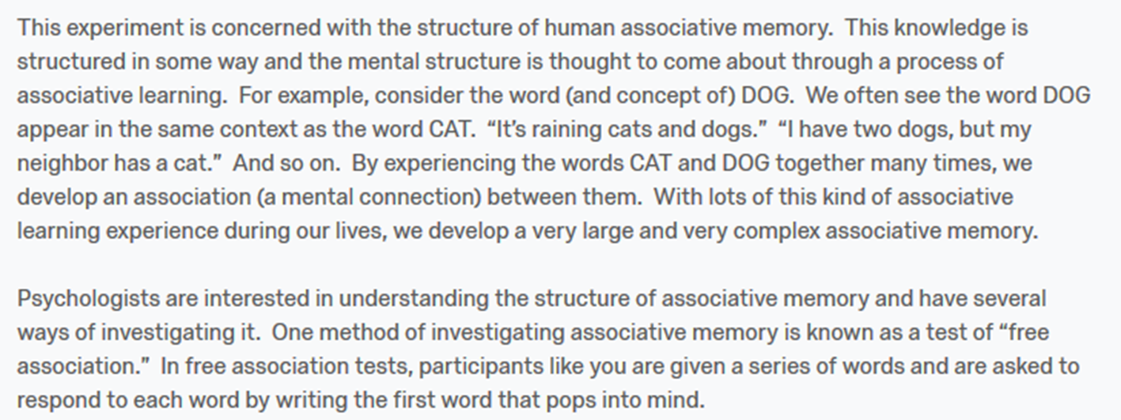
Judgment Blocks
21 word pairs per block
The instructions at the start of each block explain one of the three types of relationships (Associative, Semantic, or Thematic), and the instructions change with each block.
Judgments were made on a scale of 0 to 100, with 0 indicating no relationship and 100 indicating a perfect relationship
Three versions of the study were created, which counterbalanced the order blocks appeared in and which instruction set appeared with which item block.
This resulted in each item pair being judged on each of the three conditions.
Example from Associative Condition
Notes:
Three Judgment blocks, 21 words per block (7 low strength, 7 medium strength, 7 high strength). At the beginning of each block, participants receive instructions explaining associative, semantic, or thematic relationships and are asked to judge each word pair’s relatedness based on that criteria. These judgements are made on a scale of 0 to 100.
The picture is an example of the instructions participants receive for the associative judgment block.
There are three different versions of the study that rotate which instructions appear with which block and counter balance the order of the blocks. The end result is that each word pair receives judgements based on all three criteria.

Slide 10
Recall Phase
Participants were presented with the first word from each of the pairs they previously judged and are asked to recall the target word it was paired with.
All 63 pairs were presented in a randomized order.
Notes:
The final section of the study is a cued recall phase. In this section participants are presented with each of the 63 cue words from the judgement blocks and are asked to respond with the correct target word. The cue words appear in a randomized order and participants are allowed to take as long as needed to complete this section.

Slide 11
Study Design
IVs
DVs
Judgment type (control)
Associative Strength (FSG)
Semantic Strength (COS)
Thematic Strength (LSA)
Interactions
Single Word Norms (grouped by type)
Recall Score
Judgment Value
Notes:
The data was analyzed with a Multi-Level Model and Logistic Regression.
List IV’s and DV’s

Slide 12
Data Processing

Slide 13
Replication Analysis
Multi-level modeling was used to analyze the data.
Each participant’s individual judgment and recall ratings are treated as separate data points.
Nine out of range data points were coded as NA (e.x., data points > 100)
Five outliers were removed
1,472 data points were excluded (833 judgment only, 393 recall only, and 246 across both categories)
The final dataset used for the Experiment Two replication analyses contained 12,451 observations from 211 participants.

Slide 14
Single Word Norm Analysis
When examining single word norms, the original Experiment Two dataset was combined the dataset used in Experiment One, which was updated to contain single word norm information.
This combined dataset contained a total of 18,713 data points collected from 316 participants.
Correlations between various measures of word length (number of characters, syllables, morphemes, and phonemes) were r > .75.
Because of this, only number of characters was used to measure word length.

Slide 15
Results

Slide 16
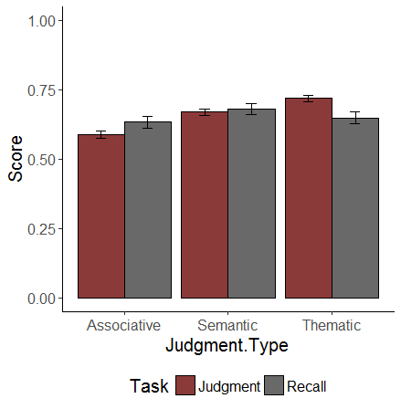
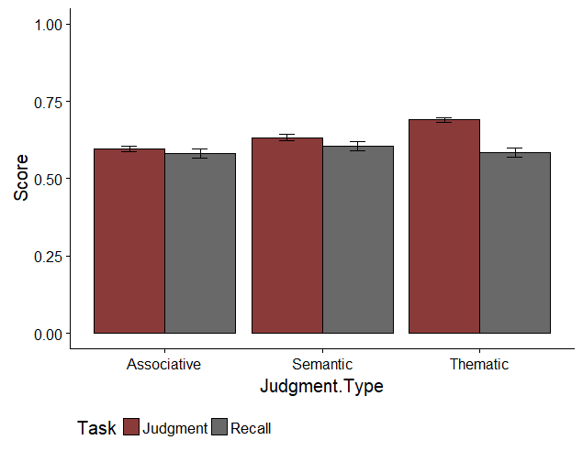
Mean Judgment and Recall Scores
Experiment One
Experiment Two
Notes:
The type of judgement being made did not effect recall. The percent of word pairs correctly recalled hovered around 60% for each of the three types of judgements. However, the type of judgement being made did have an effect on the relatedness values that participants assigned. Participants were more likely to rate the thematic relationships as being more similar. This may in part be due to the fact that thematics can be viewed as a combination of association and semantics, meaning that there is more information encoded in the word pairs for participants to work with.

Slide 17
Interaction Replication
Judgments
Recall
IV | b | Std. Error | t | p
FSG | .422 | .020 | 20.622 | < .001
COS | .011 | .011 | 1.054 | .293
LSA | .132 | .018 | 7.386 | < .001
FSG:COS:LSA | .193 | .410 | .471 | .638
IV | b | Std. Error | z | p
FSG | 1.780 | .198 | 9.081 | < .001
COS | .633 | .099 | 6.421 | < .001
LSA | .681 | .163 | 4.180 | < .001
FSG:COS:LAS | -22.464 | 3.671 | -6.119 | < .001
Notes:
These results show that both FSG and COS strength significantly predict performance on the recall task. The judged value that participants assigned to the word pairs was also a significant predictor of recall performance.
FSG is the strongest predictor of recall, followed Judged Value and COS. LSA is not a significant predictor. These results suggest that how associatively related two words are plays a strong role in how likely an individual is to remember them.

Slide 18
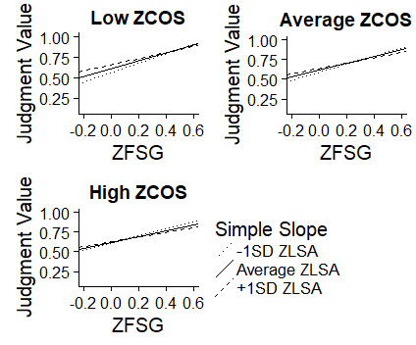
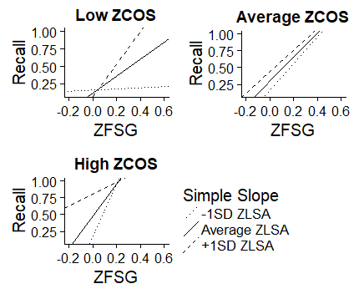
Simple Slopes for Replication
Judgment
Recall

Slide 19
Single Word Norm Analysis
Stepwise regression was used to select the strongest single word predictors for steps one, two, and three of the final model.
IVs for Final Judgment Model:
IVs for Final Recall Model:
Step 1: Length 1, Length 2, Frequency 1, Frequency 2
Step 2: AOA 1, AOA2, Familiarity 1, Familiarity 2, Valence 1, Valence 2, Imageability 1, Imageability 2, Concreteness 1, Concreteness 2
Step 3: QSS, TSS, FSS 1, FSS 2, COSC 2, Ortho 2, Phono 1
Step 4: FSG, COS, LSA
Step 1: Length 1, Length 2, Frequency 1, Frequency 2
Step 2: AOA 1, AOA 2, Familiarity 1, Familiarity 2, Valence 1, Valence 2, Imageability 1, Concreteness 2
Step 3: QSS, TSS, FSS 1, FSS 2, Ortho 1, Ortho 2, Phono 1, Phono 2
Step 4: FSG, COS, LSA
Note: 1 = Cue Item, 2 = Target Item

Slide 20
Single Word Norms – Judgments
Step | IV | b (SE) | t | p
One | SUBTLEX 1 | .014 (.003) | 4.308 | < .001
 | SUBTLEX 2 | -.032 (.003) | -9.219 | < .001
 | Length 1 | -.005 (.001) | -2.790 | .005
 | Length 2 | -.001 (.001) | -.819 | .413
Two | AOA 1 | .015 (.002) | 7.416 | < .001
 | AOA 2 | -.014 (.002) | -6.348 | < .001
 | Familiarity 1 | .075 (.013) | 5.694 | < .001
 | Familiarity 2 | -.091 (.011) | -8.160 | < .001
 | Valence 1 | -.001 (.002) | -.072 | .425
 | Valence 2 | -.022 (.002) | -10.257 | < .001
 | Imageability 1 | .053 (.005) | 10.256 | < .001
 | Imageability 2 | -.074 (.005) | -13.440 | < .001
 | Concreteness 1 | -.015 (.004) | -4.144 | < .001
 | Concreteness 2 | .045 (.004) | 10.128 | < .001
Three | QSS | .005 (.001) | -8.910 | < .001
 | TSS | -.002 (.001) | -3.676 | .160
 | FSS 1 | -.001 (.001) | -4.339 | < .001
 | FSS 2 | .001 (.001) | 4.884 | < .001
 | Ortho N 2 | .001 (.001) | 7.403 | < .001
 | Phono N 1 | -.001 (.001) | -7.789 | < .001
 | COSC 2 | -.001 (.001) | -3.288 | .010
Four | FSG | .391 (.021) | 18.186 | < .001
 | LSA | .123 (.106) | 7.919 | < .001
 | COS | .027 (.011) | 2.429 | .015
Data was entered into the analysis hierarchically.
Step 1: Lexical Properties
Step 2: Participant Ratings
Step 3: Neighborhood Connections
Step 4: Word Overlap
Note: 1 = Cue item, 2 = Target Item. FSG, COS, and LSA have been mean centered. Statistics are reported for the step in which the variable was entered into the model.

Slide 21
Single Word Norms – Recall
Step | IV | b (SE) | t | p
One | SUBTLEX 1 | -.257 (.280) | -9.234 | < .001
 | SUBTLEX 2 | .082 (.030) | 2.761 | .006
 | Length 1 | .138 (.015) | 9.225 | < .001
 | Length 2 | -.047 (.012) | -3.866 | < .001
Two | AOA 1 | -.023 (.018) | -1.331 | .183
 | AO1 2 | -.087 (.019) | -4.474 | < .001
 | Familiarity 1 | -.587 (.118) | -4.975 | < .001
 | Familiarity 2 | -.283 (.098) | -2.873 | .004
 | Valence 1 | -.143 (.020) | -7.269 | < .001
 | Valence 2 | -.012 (.019) | -.619 | .536
 | Imageability 1 | .086 (.032) | 2.697 | .007
 | Concreteness 2 | .131 (.027) | -4.838 | < .001
Three | QSS | .001 (.003) | .271 | .786
 | TSS | -.015 (.004) | -3.401 | < .001
 | FSS 1 | -.012 (.002) | -5.494 | < .001
 | FSS 2 | .015 (.002) | 7.305 | < .001
 | Ortho N 1 | -.017 (.006) | -3.023 | .003
 | Ortho N 2 | -.007 (.004) | -1.579 | .114
 | Phono N 1 | -.001 (.002) | -.117 | .907
 | Phono N 2 | -.007 (.002) | -3.087 | .002
Four | FSG | 1.866 (.210) | 8.880 | < .001
 | LSA | .867 (.146) | 4.710 | < .001
 | COS | 0.278 (.102) | 2.713 | .007
This analyses used the same hierarchical structure that was used for analyzing judgments.
Note: 1 = Cue item, 2 = Target Item. FSG, COS, and LSA have been mean centered. Statistics are reported for the step in which the variable was entered into the model.

Slide 22
Three-Way Interactions for Single Word Norms
Task | b | Standard Error | Test Statistic | p
Recall | -8.808 | 3.161 | -2.786 | .005
Judgment | .558 | .338 | 1.648 | .099

Slide 23
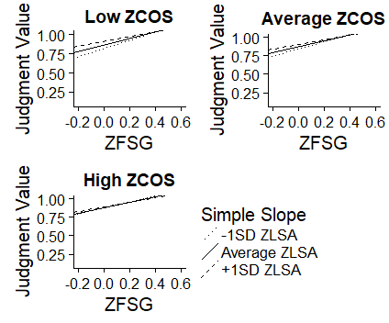
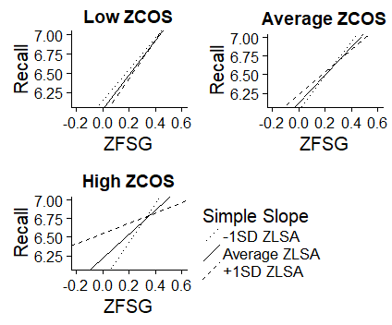
Simple Slopes for Single Word Norms
Judgment
Recall

Slide 24
Summary and Discussion

Slide 25
Summary – Interaction Replication
This study sought to replicate interaction findings from the pilot study, first when using a novel set of stimuli and then when controlling for single word norms.
First, the three-way interaction was not significant when predicting participant judgments. However, a simple slopes analysis showed that FSG and LSA strengths were competitive with another at each level of semantic overlap.
A significant three-way interaction was detected between the network norms when predicting recall, although this interaction was in the opposite direction as findings from the pilot study (FSG and LSA strength were complimentary at low levels of semantics and became increasingly competitive at high levels).

Slide 26
Summary – Single Word Norms Analysis
Similar results were found when controlling for single word norms.
No significant three-way interaction was detected when predicting judgment scores. Simple slopes analyses showed that increasing thematic overlap between pairs decreased the predictiveness of FSG at all levels of semantic overlap (i.e., competition at all levels).
When predicting recall, the three-way interaction between network norms was significant, and once again the interaction was in the opposite direction of pilot study.

Slide 27
General Discussion
Although previous studies have shown that memory networks are divided into separate systems for handling meaning and association, the presence of these interactions suggests that connections exist between these networks, linking them to one another.
One interpretation of the interaction findings is that these memory systems form a three-tiered, interconnected system.
First, information enters the semantic memory network, which processes features of concepts and provides a means of categorizing items based on the similarity of their features.
Next, the associative network adds information for items based on contexts generated by reading or speech.
Finally, the thematic network pulls in information from both the semantic and associative networks to create a mental representation of both the item and its place world relative to other concepts.

Slide 28
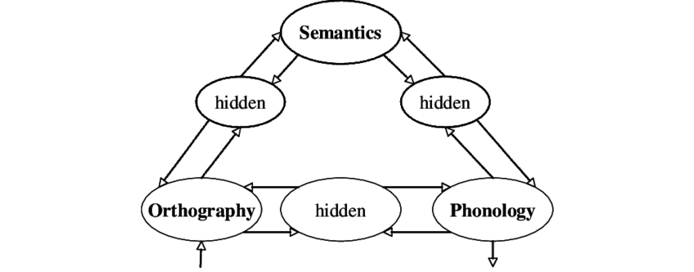
General Discussion
The present study can be viewed within the context of Seidenberg and McClelland’s 1989 “triangle model” of reading.
Model recognizes speech and reading based on phonology, orthography, and meaning.
Pathways are bi-directional.
Harm & Seidenberg (2004) developed a version of the model with a focus on semantics, with word meaning being derived from orthographic and phonographic input.
Triangle Model: Seidenberg & McClelland, 1989

Slide 29
General Discussion
In several instances, cue and target slopes appeared to balance out another in both judgment and recall models. (i.e., cue slope was positive, but target slope was negative)
The bi-directional pathways in the triangle model may explain this trend of cue and target slopes balancing out one another.
Each item appears to be individually weighted, which could indicate that the focus of attention was spread across cue and target and these were weighted evenly.

Slide 30
Limitations
Pairs were randomly selected based on cosine values. This method was used to get a range of LSA and FSG scores, but the set of norms used to generate the stimuli contained a disproportionate number of pairs that were low in FSG or LSA compared to pairs that were high in overlap.
For example, there were a total of 356 high COS pairs in the dataset. Of these pairs, 326 were low in FSG. Only two pairs in the entire dataset had high overlap on all three measures.

Slide 31
Limitations
The stimuli used in Experiment Two also had to be included across several unconnected databases of single word norms. This greatly limited which words could be selected.
To help control for this, single word norms were gathered for the stimuli set used in the pilot study. Data was then combined across experiments. This led to several NA values across each single word norm, as some of the cue and target items were used in the pilot were missing from various databases.

Slide 32
Limitations
Although mean judgment and recall scores were fairly stable across both experiments, some of the discrepancy between interaction findings (in particular the change in the direction of the interaction when predicting recall) may be remedied by using a more balanced set of stimuli.
Future studies should focus on creating overlap between current normed databases, and on creating larger, more comprehensive collections of word norms to use in these types of studies.

